Slide 1

Web Design and User Experience Engineering Final Project
Topic: Event Management Website

Slide 2



Our Team
Akhilesh Kavitkar
Kaustubh Lawale
Nithin Dornipadu
Sai Tej Sunkara

Slide 3

Introduction
Our website has been designed to facilitate the management and organization of events held by Northeastern University staff, teachers, students, and management.

Slide 4
Problem Statement
There is no platform for the events that Northeastern offers. There are various websites or social media platforms where these events are posted.

Slide 5
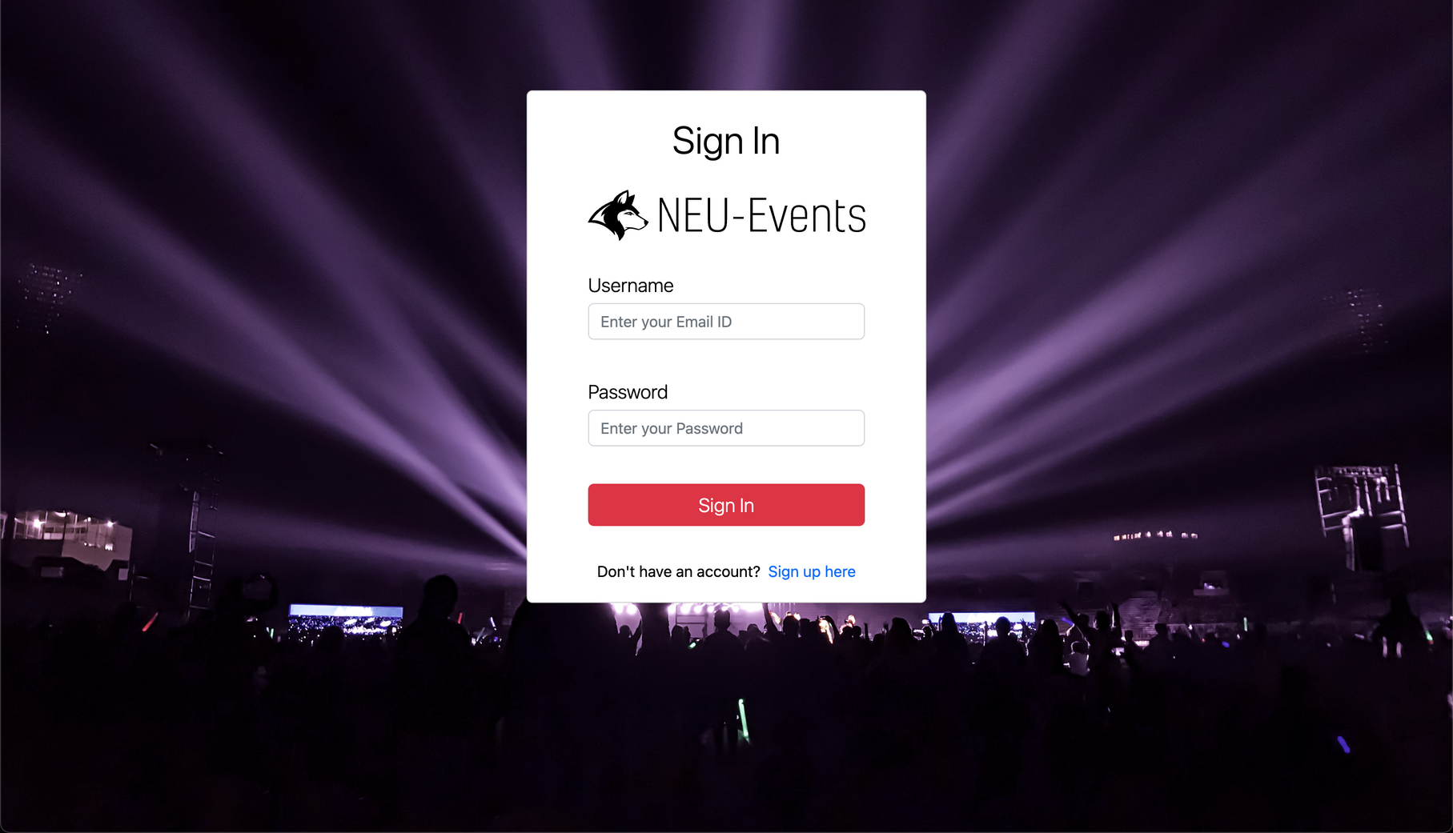
Login Page

Slide 6
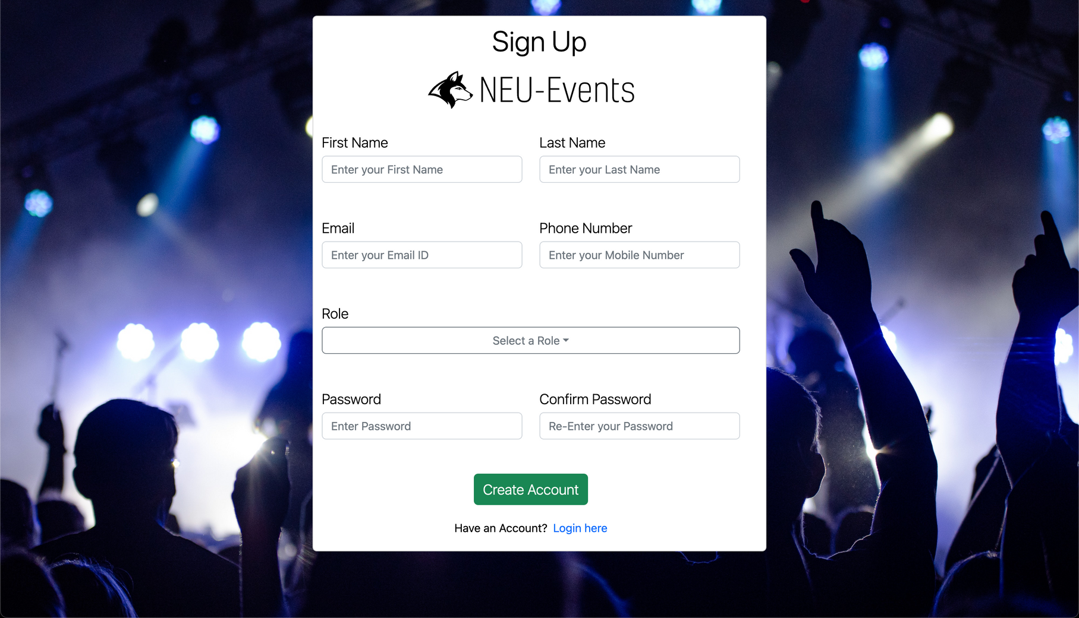
SignUp Page

Slide 7
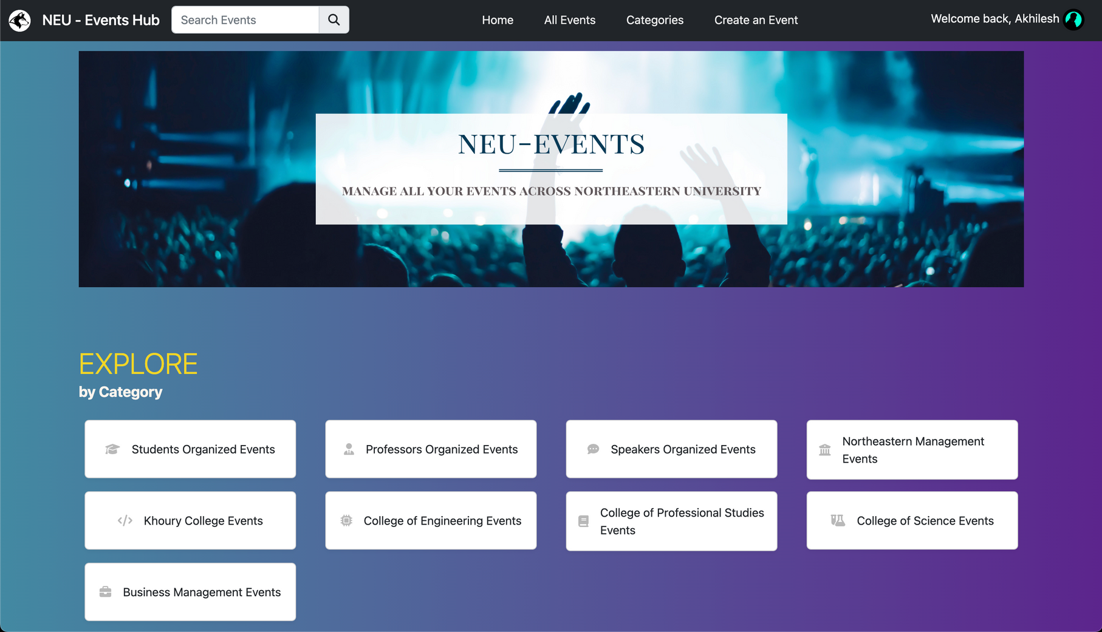
Main Page

Slide 8
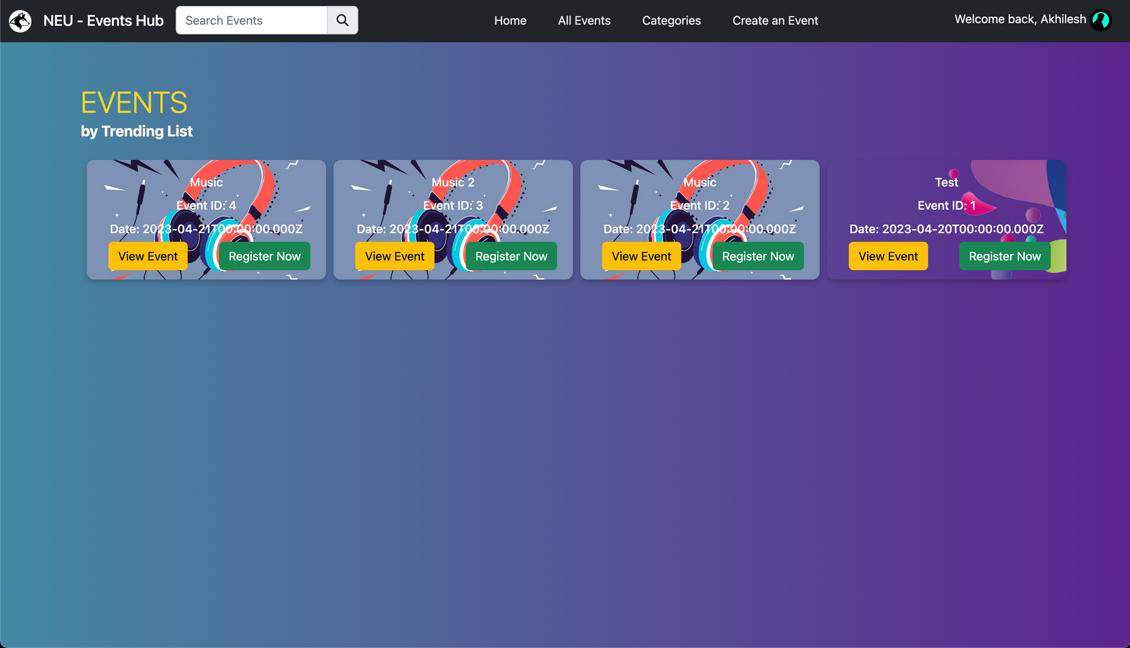
Events Page

Slide 9
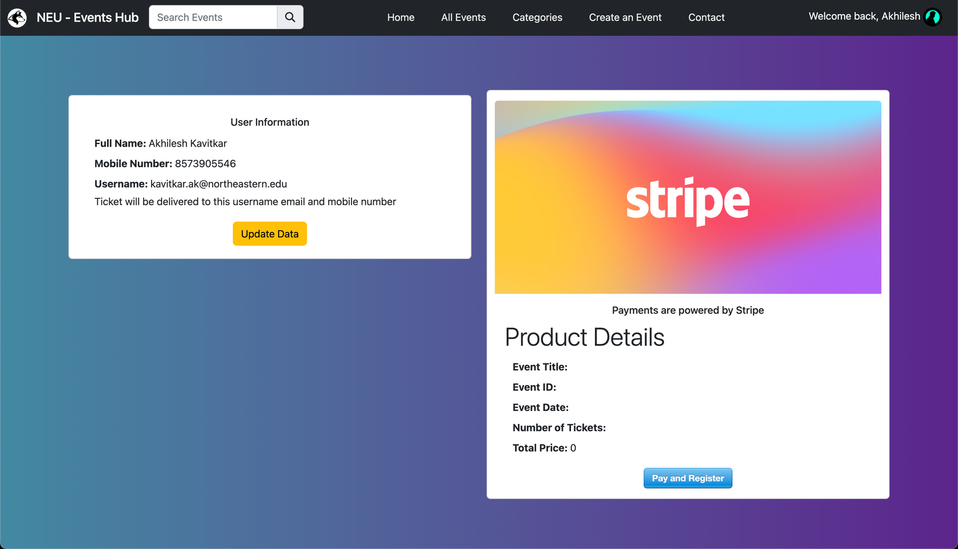
Register Page

Slide 10
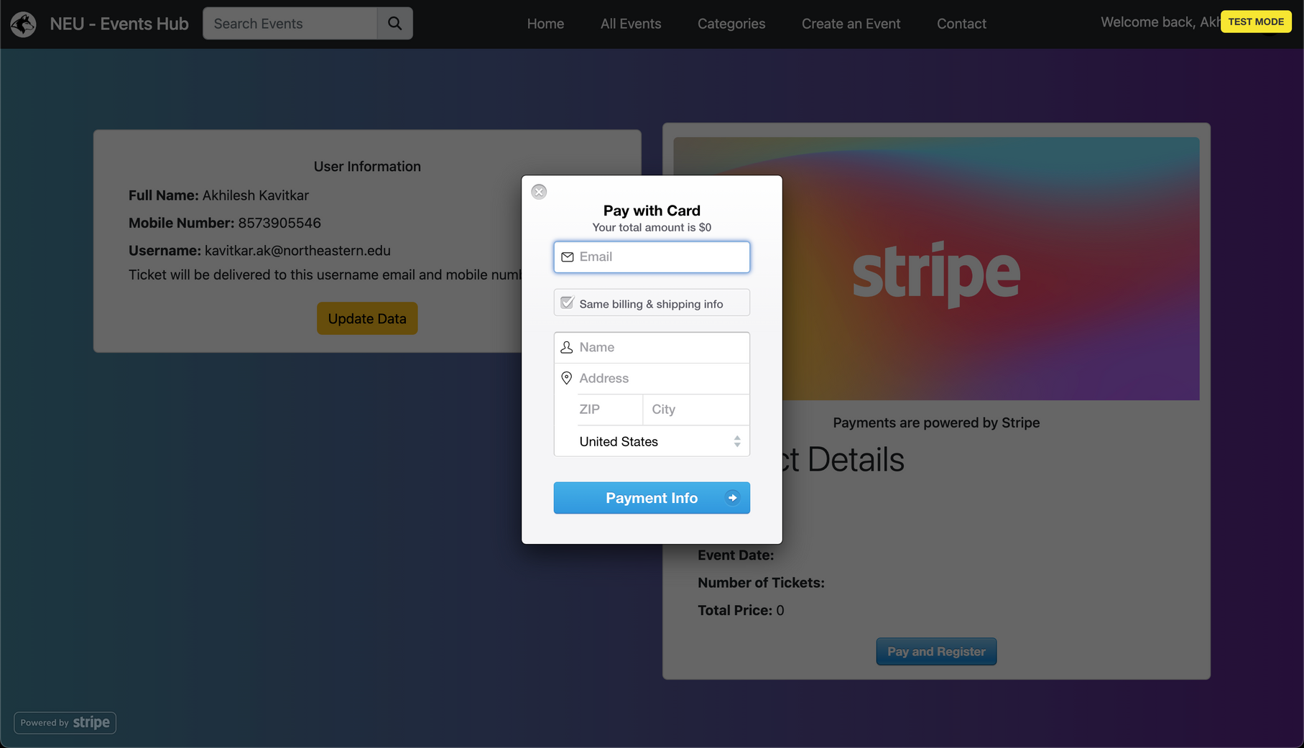
Register Page Contd.

Slide 11
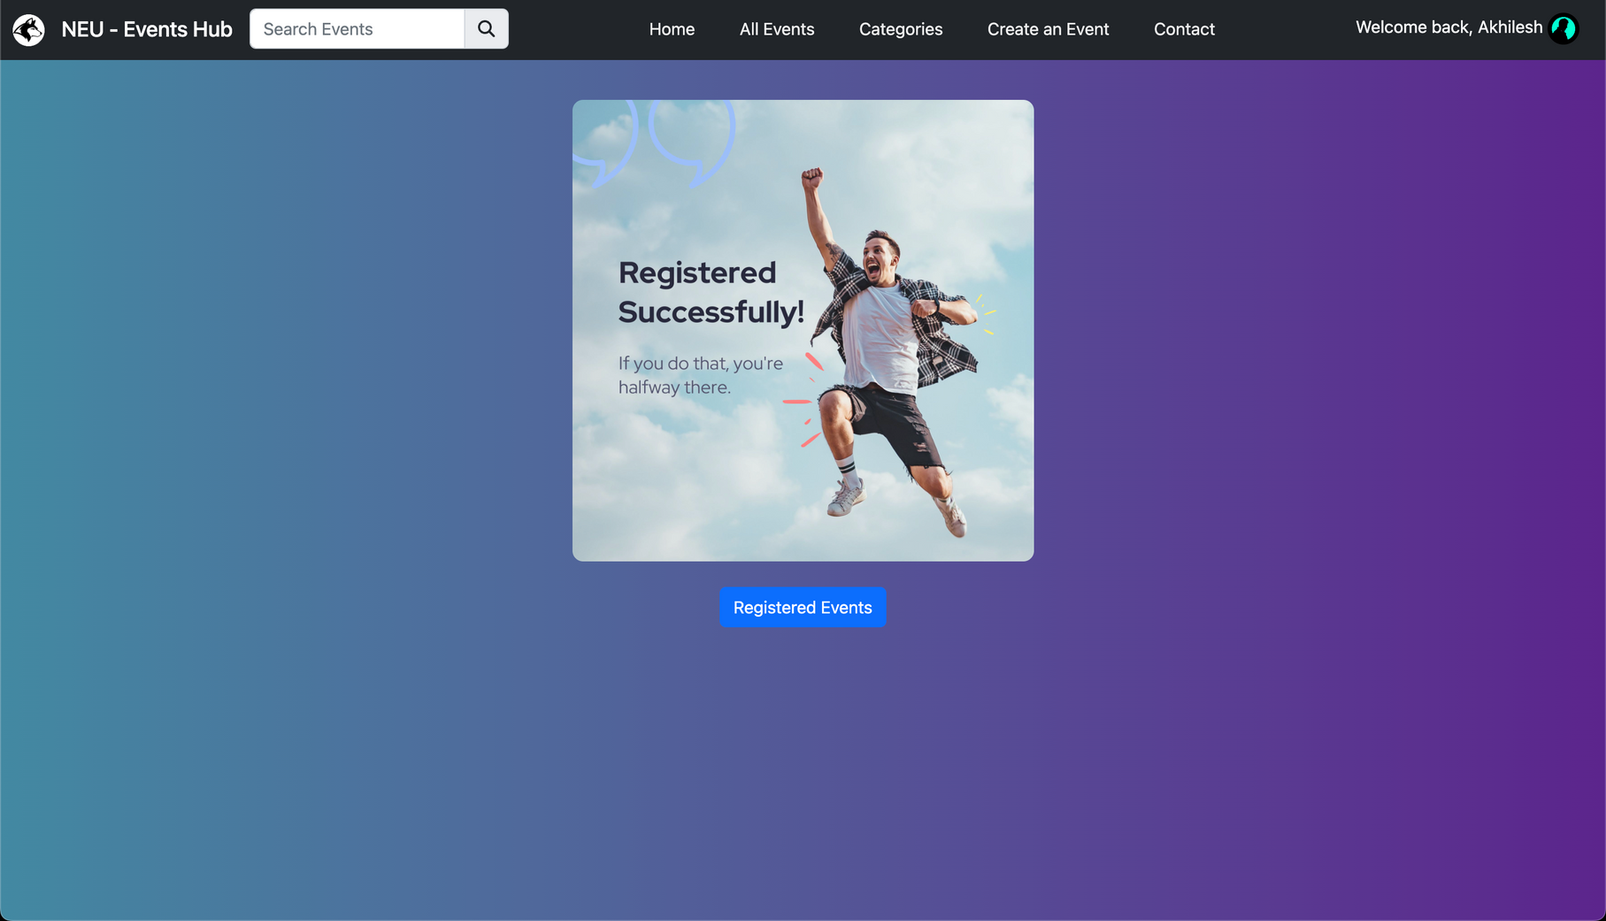
Registered Page

Slide 12
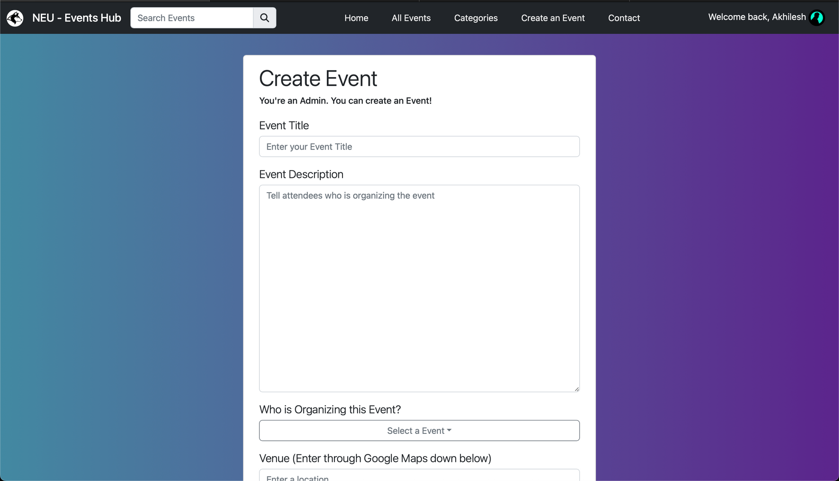
Create an Event Page

Slide 13
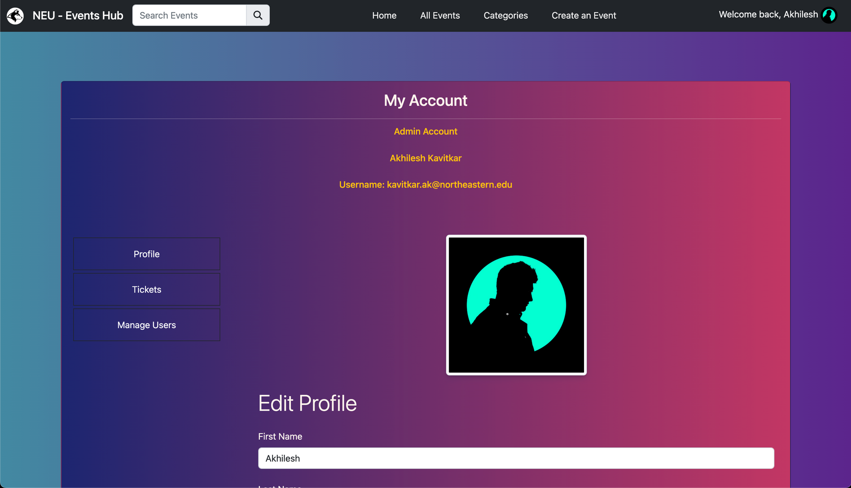
Account Page

Slide 14


Technology Used
React
MongoDB
Express JS
NodeJS
Bootstrap

Slide 15
Integrations Used
Google Maps API
Stripe
Font Awesome Icons
Unsplash

Slide 16
Solution
Instead than having so many distinct platforms or webpages for Northeastern University activities, we have built a page where all of them are listed.

Slide 17
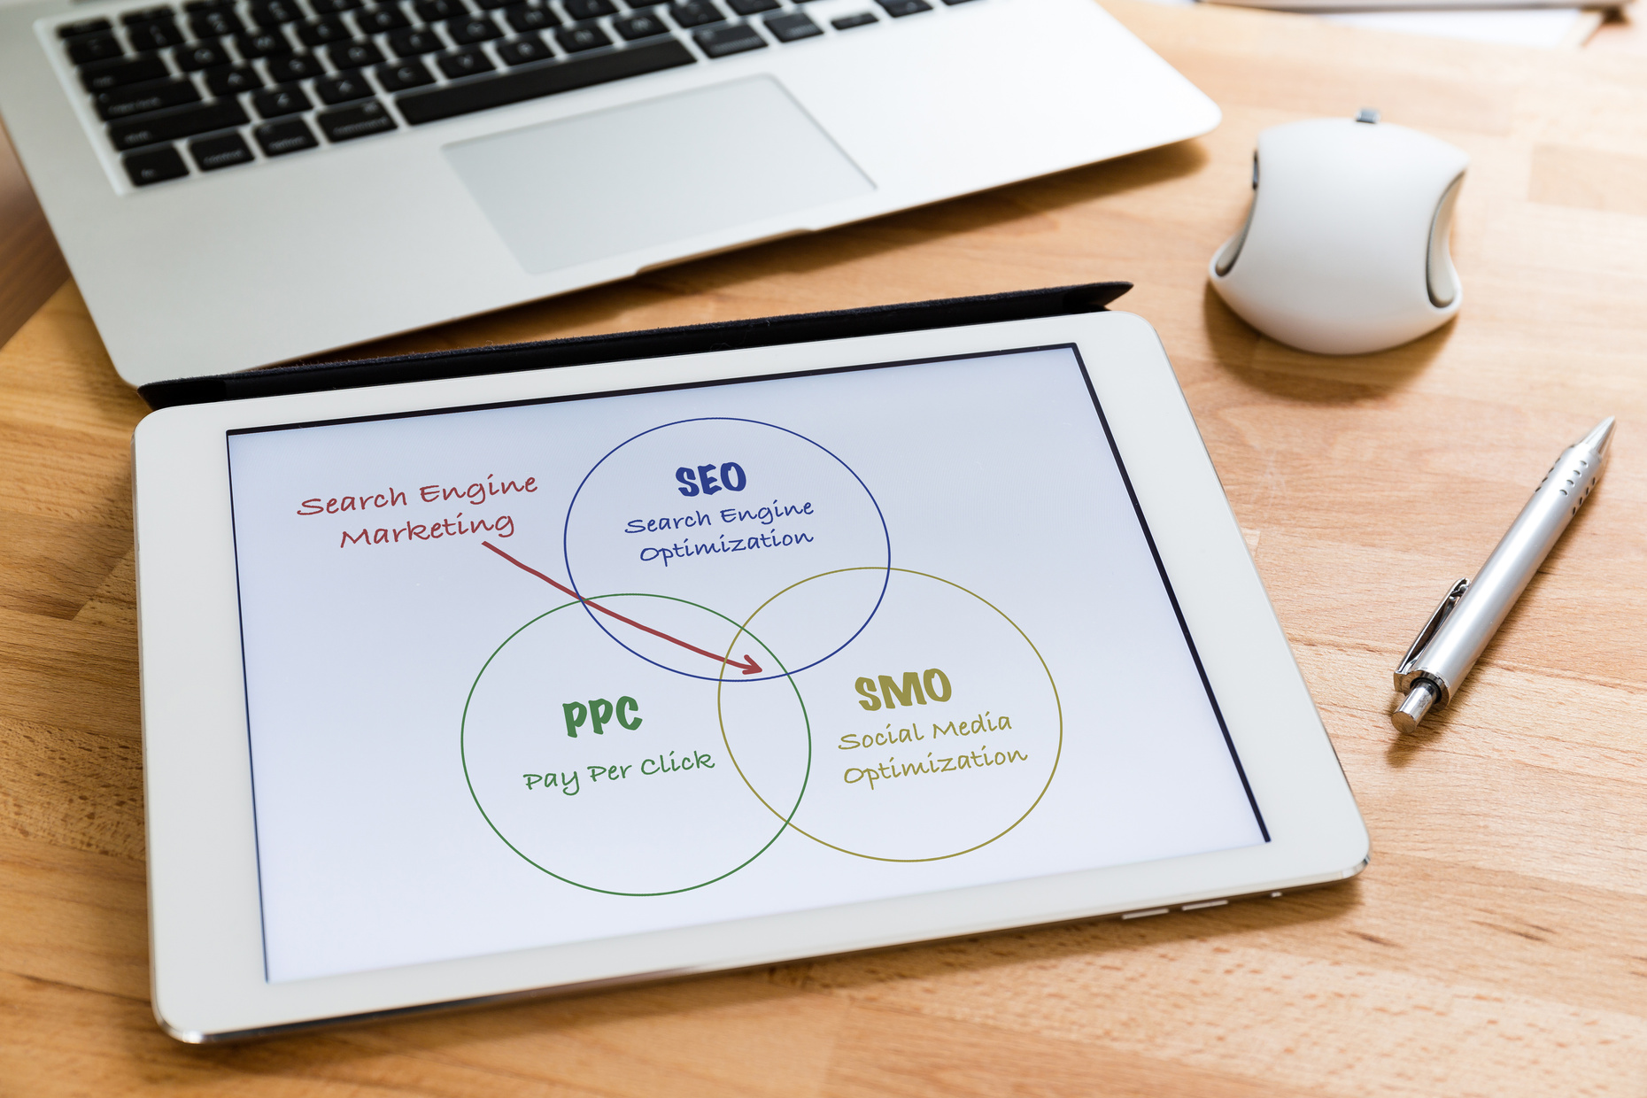
Summary
Built an end to end functional Website
Provides a scalable UI

Slide 18
Thank You
Event Management Team

